Slide 1
Code Reviewer with GPT4
By Viachaslau Lapitski
https://github.com/viachaslau-lapitski/code-reviewer
https://github.com/apps/vsl-code-reviewer

Slide 2
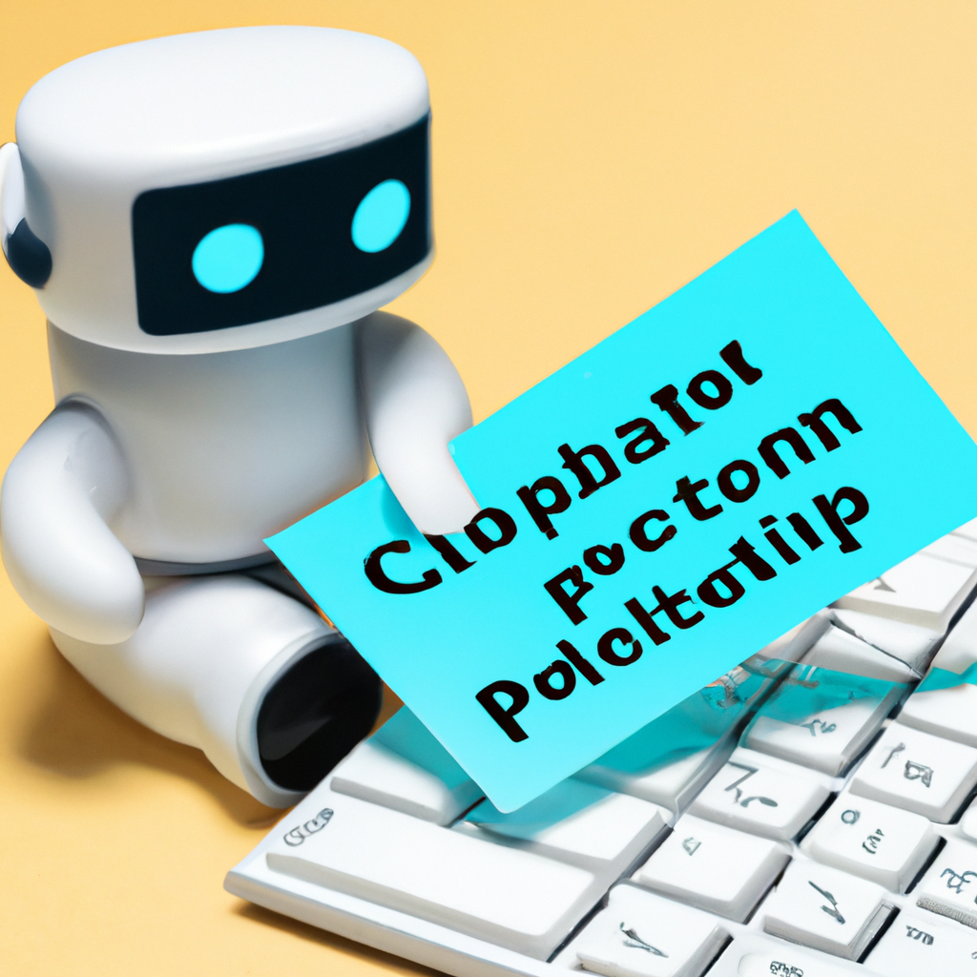
Introduction to Code-Reviewer with GPT-4
What is Code-Reviewer
Challenges in traditional code reviews
How GPT-4 is integrated into Code-Reviewer
What problems it solves
Notes:
>Brief description of what Code-Reviewer is.
Code-Reviewer is an advanced software tool designed to automate the process of code review in software development. It leverages the power of GPT-4, a state-of-the-art machine learning model, to analyze code for potential errors, adherence to coding standards, and overall quality. Code-Reviewer provides developers with immediate, detailed feedback on their code, helping them to learn, improve, and produce high-quality software more efficiently.
>
Challenges in traditional code reviews: time-consuming, possibility of human error, the need for continuous learning
>The problem that Code-Reviewer with GPT-4 is solving
Solution revolves around the time-consuming and often subjective nature of manual code reviews. In traditional software development, code reviews are performed by human reviewers who must meticulously go through lines of code to spot potential errors, ensure adherence to coding standards, and assess overall code quality. This process can be time-consuming, inconsistent, and prone to human error or bias. Additionally, it can slow down the development process, as developers must wait for their code to be reviewed before they can proceed. Code-Reviewer with GPT-4 addresses these issues by providing automated, consistent, and immediate feedback on code, thereby improving efficiency, objectivity, and the overall quality of the software development process.

Slide 3
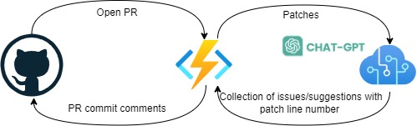
Code-Reviewer Implementation
Webhook service
Azure function app (HttpTrigger)
.NET/C#
Azure Key Vault
Azure Open AI (gpt4 model)
Github Apps
PR related events
Permissions to create PR comment

Slide 4
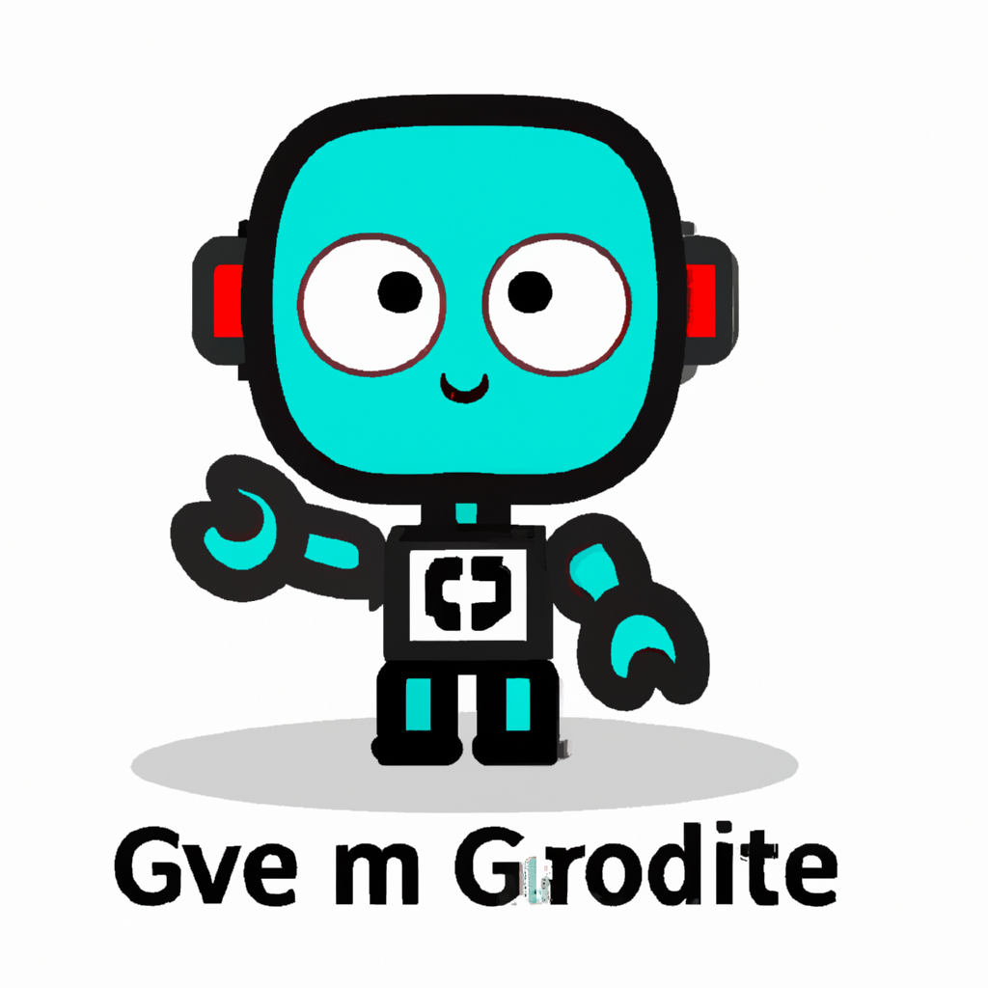
Features and Benefits of Code-Reviewer with GPT-4
Key features
Multi-Language and Platform Support
Immediate and Detailed Feedback
Integration with Development Environments
Benefits
Automated Code Review
Consistency
Learning and Improvement
24/7 Availability
Reducing Bias
Notes:
Key features
Multi-Language and Platform Support: One of the standout features of Code-Reviewer with GPT-4 is its ability to conduct reviews across multiple programming languages and platforms. This versatility makes it an invaluable tool for diverse teams working on multi-language projects or across different development environments. Whether your team is coding in Python, Java, C++, or any other supported language, Code-Reviewer with GPT-4 can provide consistent, detailed, and immediate feedback. Furthermore, its ability to integrate with various development platforms ensures a seamless code review process, regardless of your team's preferred tools or workflows. This broad compatibility enhances team flexibility and ensures high-quality code review standards are maintained across all your projects.
Immediate and Detailed Feedback: The tool provides immediate feedback on the code, pointing out potential issues and suggesting improvements. The feedback is detailed and includes explanations, helping developers understand the reasoning behind the suggestions and learn from them.
Integration with Development Environments: Code-Reviewer with GPT-4 can be integrated with popular development environments and version control systems. This allows developers to use the tool within the platforms they are already familiar with, making the code review process seamless and efficient.
Benefits
Automated Code Review: GPT-4 can automatically review code, saving developers time and allowing them to focus on more complex tasks. It can also provide immediate feedback, speeding up the development process.
Consistency: GPT-4 can help ensure consistency in code review by applying the same standards to every review. It won't miss potential issues due to fatigue or oversight, which can sometimes happen with human reviewers.
Learning and Improvement: GPT-4 can provide detailed explanations for its suggestions, helping developers learn and improve their coding skills. It can also help enforce best practices and coding standards.
24/7 Availability: Unlike human reviewers, GPT-4 is available 24/7 for code reviews. This can be particularly beneficial for distributed teams working in different time zones.
Reducing Bias: GPT-4 reviews code based on predefined standards and does not have personal biases. This can help create a more fair and objective code review process.

Slide 5
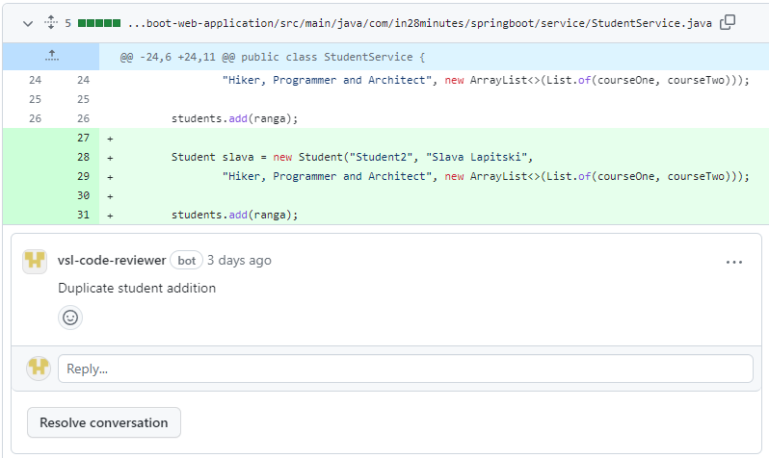
Case Studies and Success Stories
Testing
Upcoming features
Impact on productivity and code quality
Call-to-action
Notes:
Highlight upcoming features or plans for the app.
End with a call-to-action for your audience, such as trying out the app, providing feedback, or contributing to its ongoing development.
"The impact of Code-Reviewer with GPT-4 on productivity and code quality is significant. By automating the code review process, it reduces the time developers spend on reviewing code, allowing them to focus more on coding and problem-solving. This leads to increased productivity and faster development cycles.
In terms of code quality, Code-Reviewer with GPT-4 provides consistent and detailed feedback on potential issues and improvements, helping developers to write cleaner, more efficient code. It also helps enforce coding standards and best practices, leading to a higher overall standard of code in your projects.
Furthermore, the 24/7 availability of Code-Reviewer with GPT-4 means that code can be reviewed at any time, making it particularly beneficial for distributed teams working in different time zones. This leads to a smoother, more efficient development process, with fewer delays waiting for code reviews.
Finally, by providing detailed explanations for its suggestions, Code-Reviewer with GPT-4 also serves as a learning tool, helping developers to continually improve their coding skills and knowledge. This leads to a higher level of skill and expertise within your team, further enhancing productivity and code quality."

